Slide 1
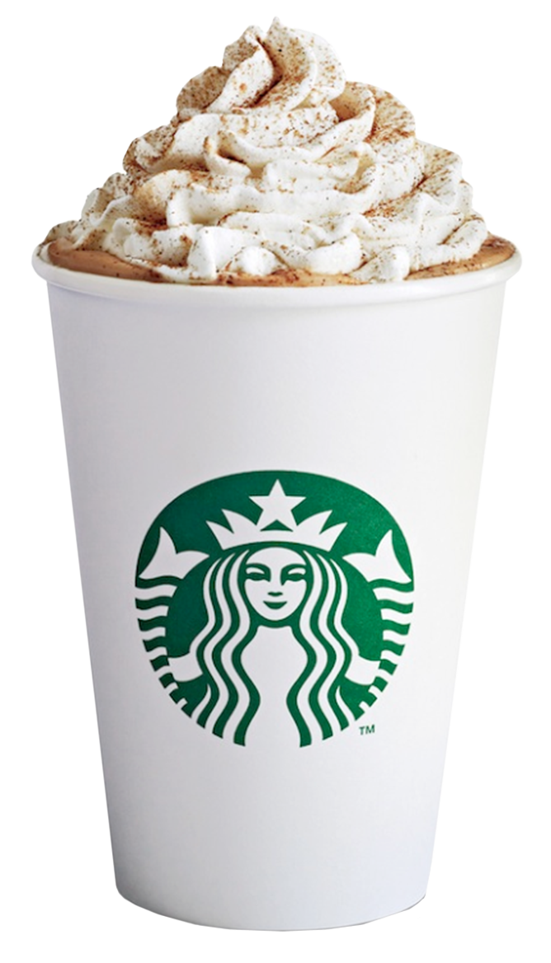
Personalized Marketing
Mentor: Richard Sharp
Nicole Bridgland, Yiying Cheng, Tianyi Mao,
Hieu Nguyen, Kelly O'Connell, Anna Srapionyan

Slide 2



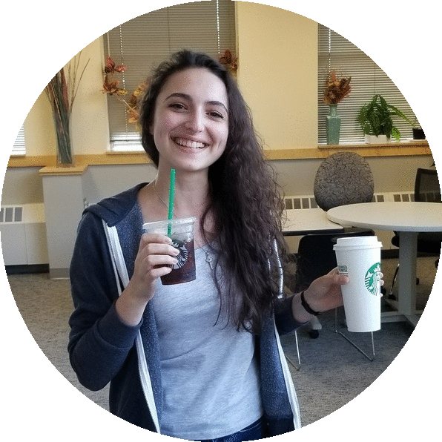

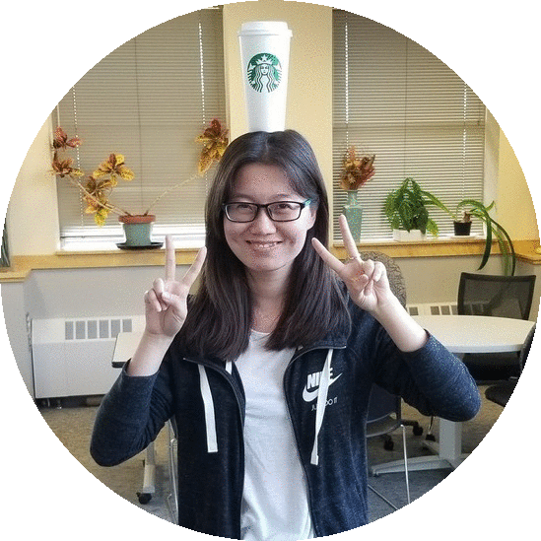

Hieu
Nicole
Richard
Anna
Tianyi
Kelly
Yiying

Slide 3
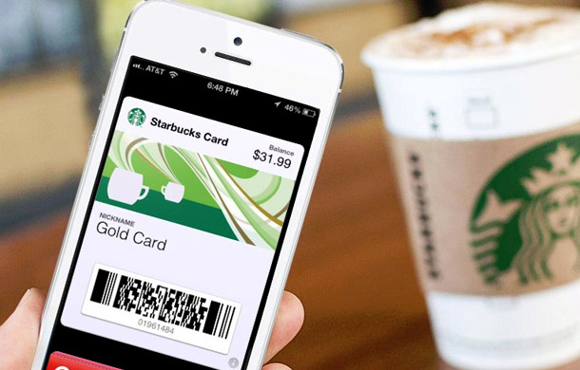
Targeted Offers
Disclaimer: This project is a hypothetical approach to personalization and does not make use of proprietary data or methods owned by Starbucks.
For more information about the methods used in this project or personalization at Starbucks please see [https://arxiv.org/abs/1002.4058 or http://www.dmnews.com/customer-experience/ai-informs-personalization-for-starbucks/article/630229/ ].
How does a company know which offers to send, at what time, to whom?
Notes:
One way to increase revenue is through the use of offers (buy one get one, spend $5 and get $2 back, etc.)a

Slide 4
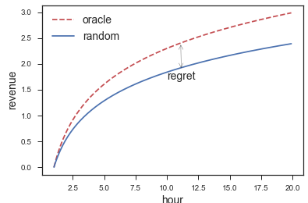
Goal: Minimize Regret
Put regret/oracle graph here
Regret = the extra revenue we could have earned, if we had known the optimal strategy
Design a feedback-based algorithm to continually improve our offer strategy
Notes:
Best offer strategy=minimal regret
So what do we mean by a feedback-based algorithm? … next slide transition

Slide 5
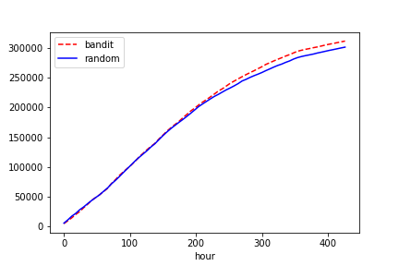
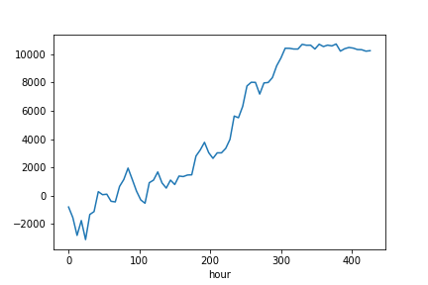
Results
+$243,300,000
in one year
10 million customers
Notes:
In case anyone asks “why 10 million customers”, Starbucks has 24000 stores, each has 500 customers/year.

Slide 6
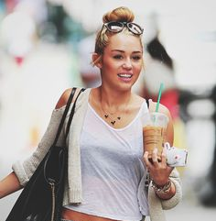

Data
In reality:
People provide data through profiles or accounts, e.g. Starbucks app
Preferences are remembered through transaction history
In our project:
Data is produced by a decision simulator
Purchase decisions are made based on a hypothetical individual’s tastes and preferences

Slide 7

Learning Cycle
Send offers
(Segments)
Measure effects (KPIs)
Decision Strategies

Slide 8
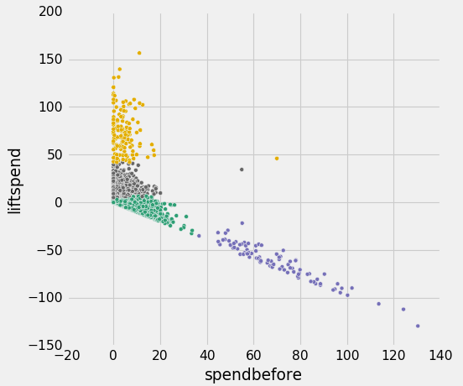
Segmentation
Generated segments using k-means
Based on transaction history and demographic data
Prioritized spending habits and reactions to offers

Slide 9
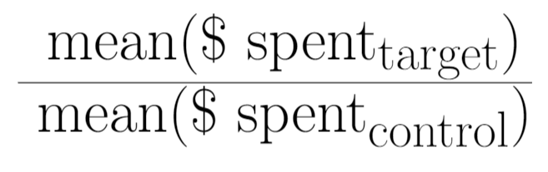
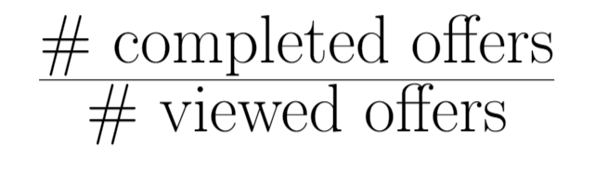
Key Performance Indicators
Examples:
KPI1 =
KPI3 =
KPIs demonstrate how effectively a company is achieving key business objectives.
KPI = 0.32 x KPI1 + 0.16 x KPI3 + 0.32 x KPI4 + 0.1 x KPI5 + 0.1 x KPI6
Revenue Completed offers Transactions $/Views #/Views

Slide 10



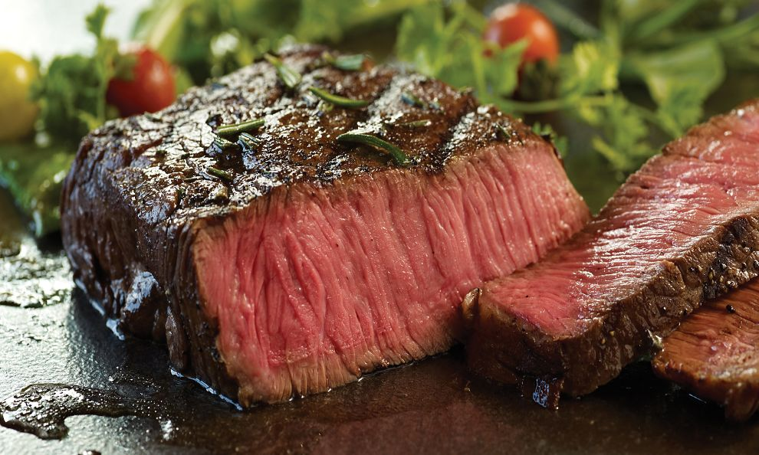
Decision Strategies
Problem:
Which offer shall we send to a certain customer?
Idea
Evaluate feedback from customer behaviors using KPIs
Reinforcement learning, using contextual bandit algorithm
Send next offers according to updated strategy

Slide 11

So what?
Algorithm helps the marketing team make decisions more efficiently
Eventually, algorithm should maximize revenue by assigning offers optimally
With more time, algorithm could be made smarter
+$243,300,000
+$???,000,000,000,000

Slide 12


Thank You!

